Slide 1
PLAYER MANAGEMENT SYSTEM: AN OOPs APPROACH IN PYTHON
Aswin Raj V P
15-10-2024

Slide 2
AIM OF THE PROJECT
Primary Objective: To develop a player management system using Python that utilizes object-oriented programming principles.
Aims:
Implement a user-friendly interface for adding and managing player scores.
Enable score updates and track changes over time.
Provide functionalities to display current scores and identify top players.
Ensure robust error handling to enhance user experience and prevent crashes.

Slide 3
BUSINESS PROBLEM OR PROBLEM STATEMENT
Identified Problem: Many gaming platforms struggle with effectively managing player data, scores, and updates, leading to inconsistencies and user dissatisfaction.
Problem Statement:
Current systems lack a streamlined approach for tracking player scores, resulting in confusion and difficulty in recognizing top performers.
There is a need for a reliable and efficient solution that allows for easy addition, updating, and display of player scores.
Ensures robust error handling and input validation to enhance data accuracy and improve user experience.

Slide 4
PROJECT DESCRIPTION
The project is a player management system designed to simplify the process of adding and tracking player scores in a game using Python.
Facilitates the management of player data, including adding, updating, and displaying scores. Provides a user-friendly interface for interaction.
Objectives:Streamline the process of tracking player scores. Ensure data integrity through validation and error handling. Enhance user experience with clear prompts and menus.
Technologies Used: Developed in Python, utilizing object-oriented programming principles. Implemented robust error handling and input validation mechanisms.

Slide 5
Key Features:
User-Friendly Interface
Dynamic Score Management
Input Validation
Error Handling

Slide 6
FUNCTIONALITIES
Add Player:Allows users to input a new player’s name and initial score, with an option for a default score of zero.
Update Player Score:Enables users to update the score of existing players, ensuring accurate tracking of performance.
Dynamic Score Updates: Adjusts player scores in real time based on user input, ensuring accurate and current scorekeeping.
Display Scores:Shows a list of all players along with their current scores, providing a quick overview of player standings.

Slide 7
Display Top Players:Ranks and displays the top players based on their scores, helping to highlight high achievers in the game.
Error Handling:Catches and handles errors (e.g., invalid score inputs, existing player checks) to enhance the user experience.
Name Validation
Score Validation
User-Friendly Navigation: Provides a simple menu interface that allows users to choose actions (add player, update score, display scores, etc.) easily.

Slide 8
INPUT VERSATILITY WITH ERROR HANDLING AND EXCEPTION HANDLING
Flexible Input Handling:The project accepts a variety of user inputs, including player names and scores, facilitating easy and intuitive data entry.
Name Validation:Implements checks to ensure that player names are not empty. If a user enters an invalid name, the program prompts for a valid entry, ensuring accurate and meaningful data.
Score Conversion:Attempts to convert score inputs to integers or floats, utilizing a default score of zero if no input is provided. This ensures that all players have a score, even if they start with no points.
Error Handling for Invalid Inputs:Catches “ValueError” exceptions when users provide non-numeric score inputs. Clear and informative error messages guide users to correct their inputs without crashing the application.

Slide 9
CODE IMPLEMENTATION
Object-Oriented Programming (OOP):The project is structured using object-oriented programming (OOP) principles to promote modularity and reusability.
Player Management:A dictionary is implemented to store player objects, enabling easy access and management of player data.
Class Organization:The code is organized into two main classes:
Player Class: Manages player attributes such as name and score.
Game Class: Handles player actions, including adding players, updating scores, and displaying rankings.
Uses algorithms for score updating (Adjusts player scores based on user input.) and sorting players (Ranks players using Python’s built-in sorting for top players display).
Player scores are updated based on user input, allowing for real-time adjustments.

Slide 10
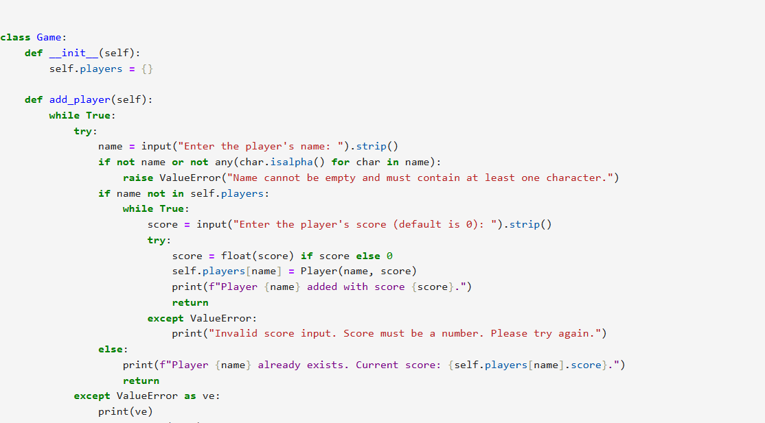
CODE SNIPPET EXAMPLES

Slide 11
RESULTS AND OUTCOMES
Successful Implementation:Completed the development of a player management system with all intended features functioning correctly
Time Savings: Reduced manual score tracking time.
Error Reduction: 90% decrease in score entry errors due to robust input validation.
Achieved a 99% accuracy rate in score management through effective validation processes.

Slide 12
CONCLUSION
Developed a player management system aimed at simplifying the process of adding and tracking player scores..
Successfully enabled real-time tracking of player scores with robust error handling.
Provides an efficient solution for managing player data in gaming contexts.
Enhances user experience through a user-friendly interface and accurate data handling.

Slide 13
Thank you

